Slide 1
Problem set 3
Question 1
Plurality

Slide 2
Problem Statement
Firstly giving votes to the candidates.
Finding maximum votes given to a candidate.
Printing the name of winner/winners( if they have equal maximum votes)

Slide 3
Giving votes to candidates
bool vote(string name)
{
for (int i = 0; i < candidate_count; i++)
{
if (strcmp(candidates[i].name, name) == 0)
{
candidates[i].votes += 1;
return true;
}
}
return false;

Slide 4
Checking the Maximum number of votes
void print_winner(void)
{
int max = candidates[1].votes;
for (int i = 0; i < candidate_count; i++)
{
if (max < candidates[i].votes)
{
max = candidates[i].votes;
}
}

Slide 5
Announce Result & If election tie
Print the names of candidates who have maximum number of votes.
for (int j = 0; j < candidate_count; j++)
{
if (candidates[j].votes == max)
{
printf("%s\n", candidates[j].name);
}
}

Slide 6
Question 2
Runoff
Solution for Plurality

Slide 7
Vote function
Checking the name of the candidate
Adding vote information into preference 2d array

Slide 8
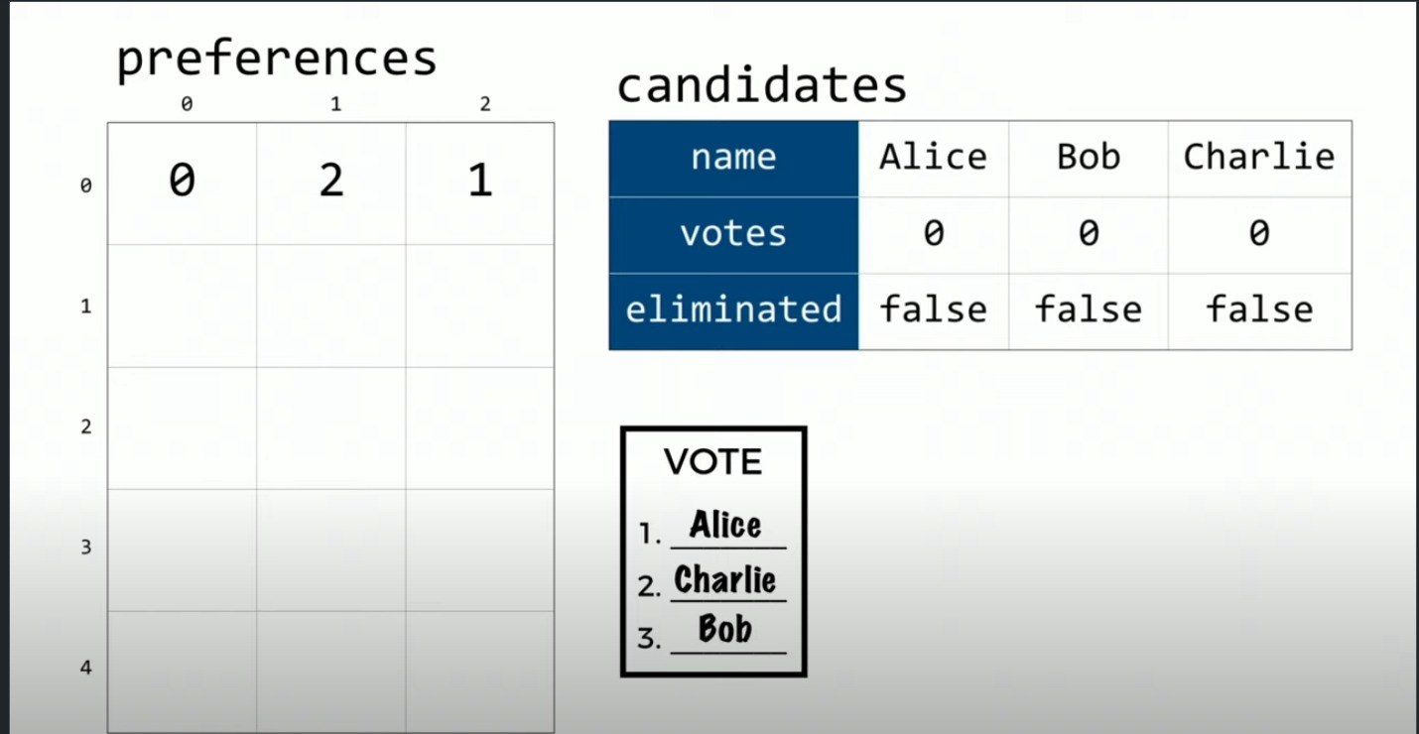
Tabulate function

Slide 9
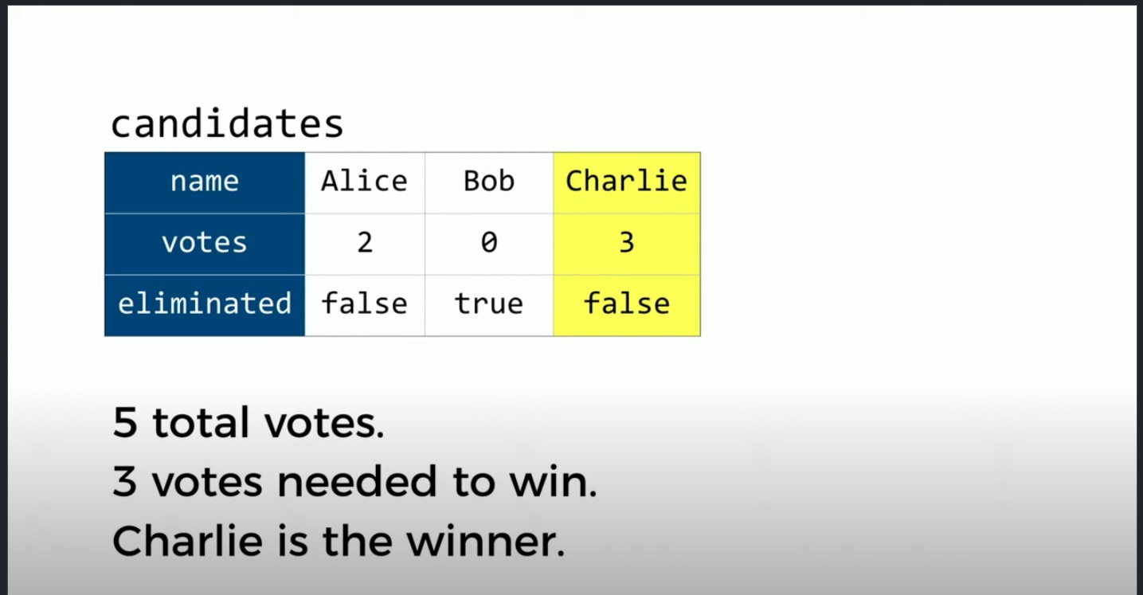
Print Winner
Print the name of the winner having more then half of the votes in the election

Slide 10
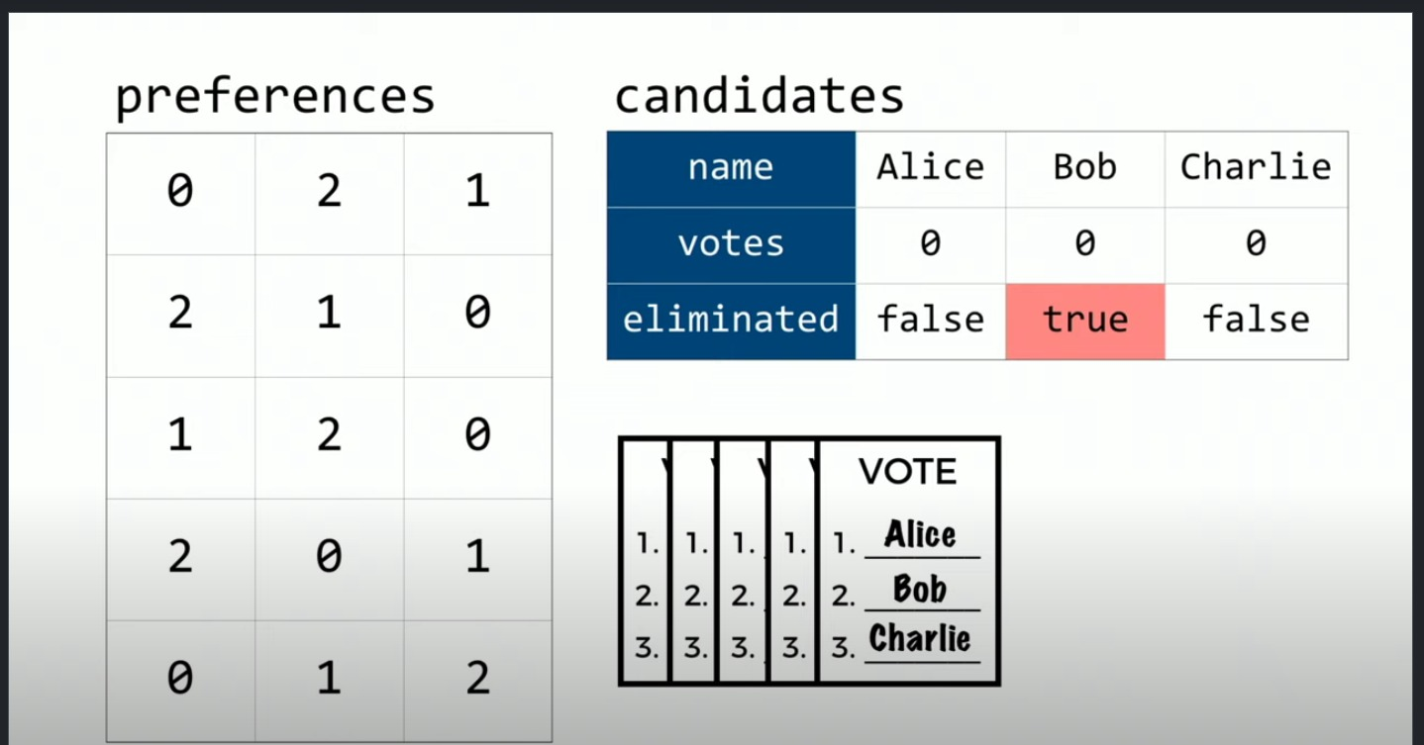
Find min function

Slide 11
Is tie
Returns true if the election is tied between remaining candidates otherwise return false
Eliminate
Eliminates the candidates with minimum numbers of votes

